Slide 1

Daily Meal Solutions
Project (KCS-753)
Team Members:
Abhinav Shukla (1816410011)
Akashdeep Soni (1816410036)
Anubhav Srivastava (1816410064)
Varchasv Shukla (1816410307)
Branch and Section: CS-4B
Project Id: 22B12
Submitted to:
Mr. Saumendu Bose

Slide 2

Daily Meal Solutions

Slide 3
Table of Contents
Objective
Importance and Need
Methodology
Technology Domain
ARCHITECTURE
Hardware/Software Specifications
Feasibility Study
Academic Objectives
Project Flow Diagram
Flow Chart
Snapshots
Results and Conclusion
References

Slide 4
Objective
Hunger is a felling of discomfort caused by lack of food and desire to eat.
It is detrimental to child’s ability to learn grow and stay healthy.
People go hungry because of inflation,high food prices,climate change diminishing natural resoruce and many other factors .
The objective of the project is to provide daily meal to the people who are hungry, people who are not able to cook their own meal on a daily basis and are looking for a daily meal solution.

Slide 5
Importance and Need
As nowadays, we see in india the number of people living outside their home is increasing day by day. They are not able to make their food on the daily basis. This seems to be a big problem sometimes when it comes to time management, as cooking food requires much time and effort.
Students living far from their home try to subscribe the tiffin services, but sometimes it becomes very difficult for them to find a tiffin service that provides quality, hygienic and healthy food.
So the above problem for students and the working sector of our country encourages us to bring such a solution that resolves the above problem.
The primary reason to choose this topic is that it will somewhere save the time of people and will ensure a quality and healthy meal.

Slide 6
Methodology
The user and the food provider both will be having different interfaces, the user will order from its end and the food provider will come to know about the orders.
When it comes to daily subscriptions the there is no need to order daily the order will be delivered based on the plan subscribed.
For any kind of changes to the meal or any kind of other requests, there will be another section to the user interface.

Slide 7
Technology Domain
Technology
Web Application / Web Services
Stack
MERN (MongoDB, Express, React, Node)
Frontend
React.js
Backend
Node.js
Express.js (Framework)
Database
MongoDB
Mongoose (ODM)

Slide 8
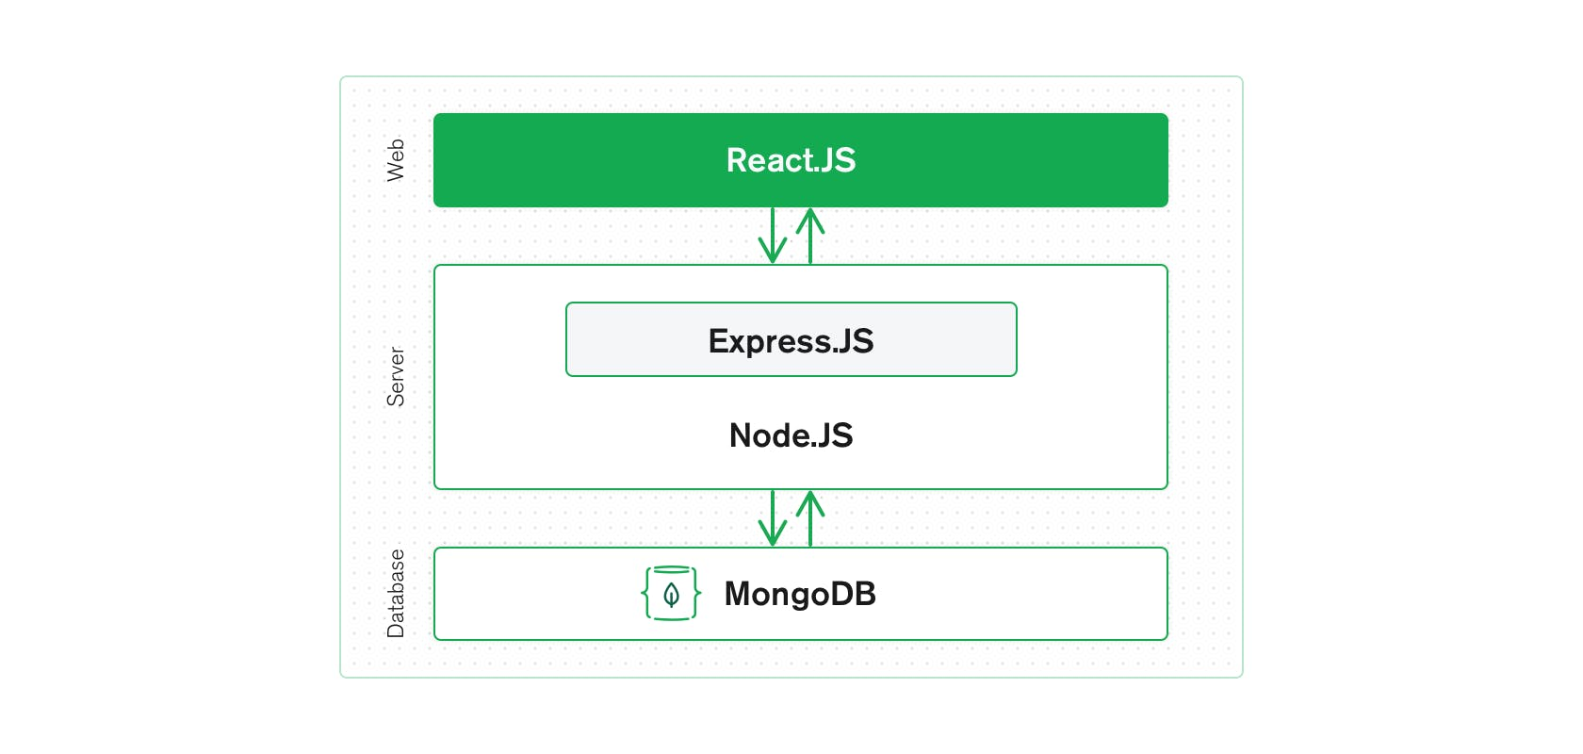
Architecture

Slide 9
Hardware / Software Specification
Hardware used
Processor: i3 or better
RAM: 2GB or more
Storage: 2GB or more
Software used
Editor: Visual Studio Code
Browser: Chrome or Firefox
Version Control: Git

Slide 10
Feasibility Study
Technical feasibility – Project is technically feasible as all the technical requirements have been analysed and are easily obtainable.
Operational feasibility – Project is operationally feasible as the project will contain an easy to use gui and a guide.
Economic feasibility – project is economically feasible as it will be build using open source softwares and library which are free to use.
Legal feasibility – Project is legally feasible as all modules used permit usage from open source and non-monetized applications.
Schedule feasibility – Project is schedule feasible as the project can be completed within the said deadline.

Slide 11
Academic Objectives
Devlope a web app which has the full stack capability.
Web App will have frontend, backend and database.
Develope the frontend using react.js framework
Develope the backend using express.js framework
Develope the database using Mongoose ODM.

Slide 12
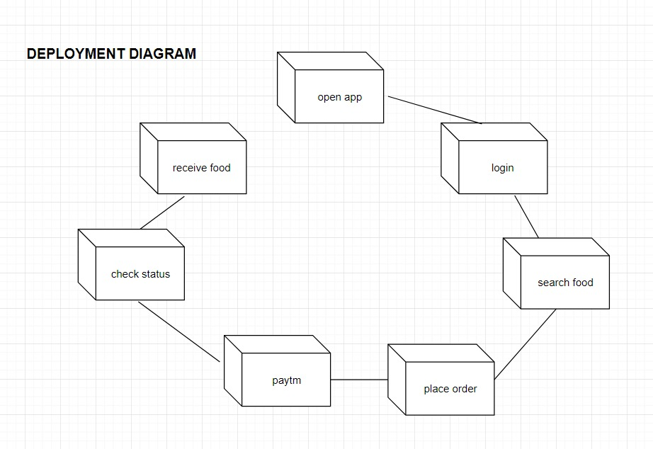
Project Flow Diagram

Slide 13
Home
Flow Chart
Item
Item = 0
Select
Product
Menu
My Cart
Continue
Shopping
Item > 0
Login
No
Select
Category
Proceed to
Checkout
Sign In
Yes
Correct
View Product
Payment
Information
Add to Cart
Yes
No
Review
Order
Order
Confirmation
Check Out

Slide 14
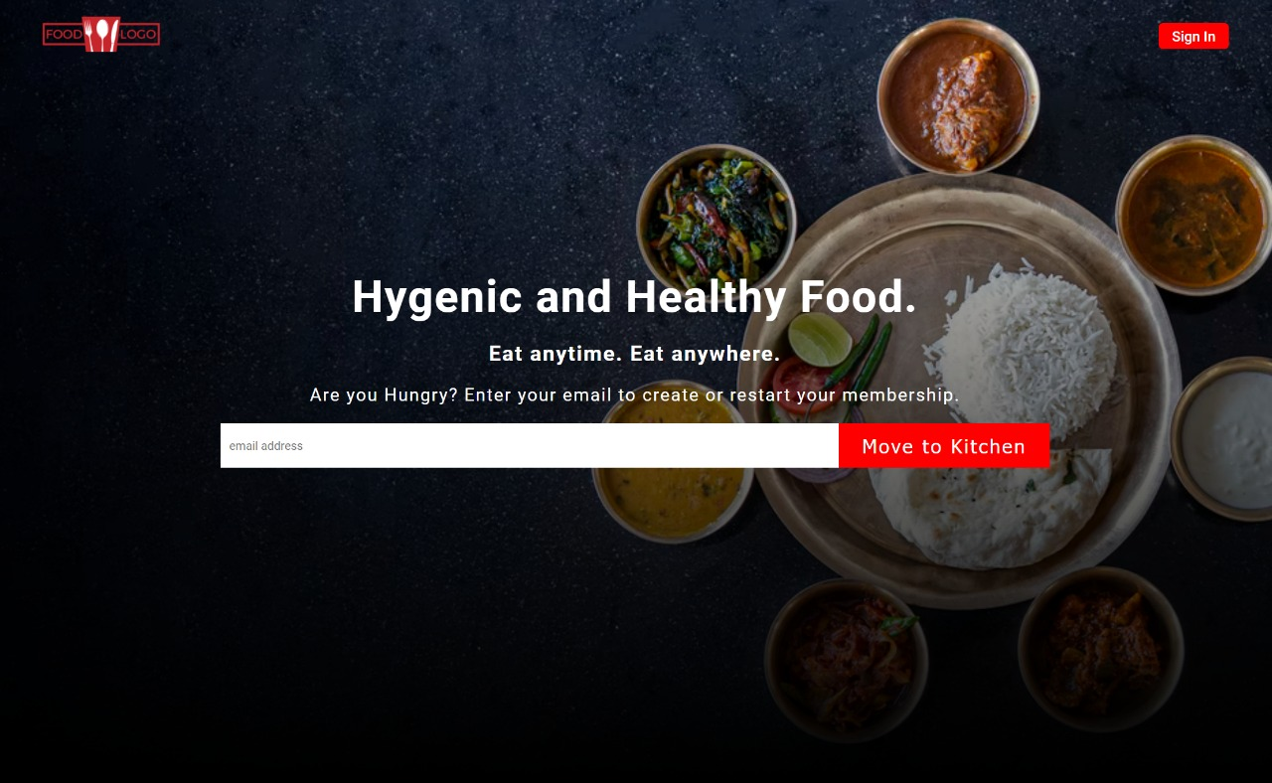
Snapshots

Slide 15
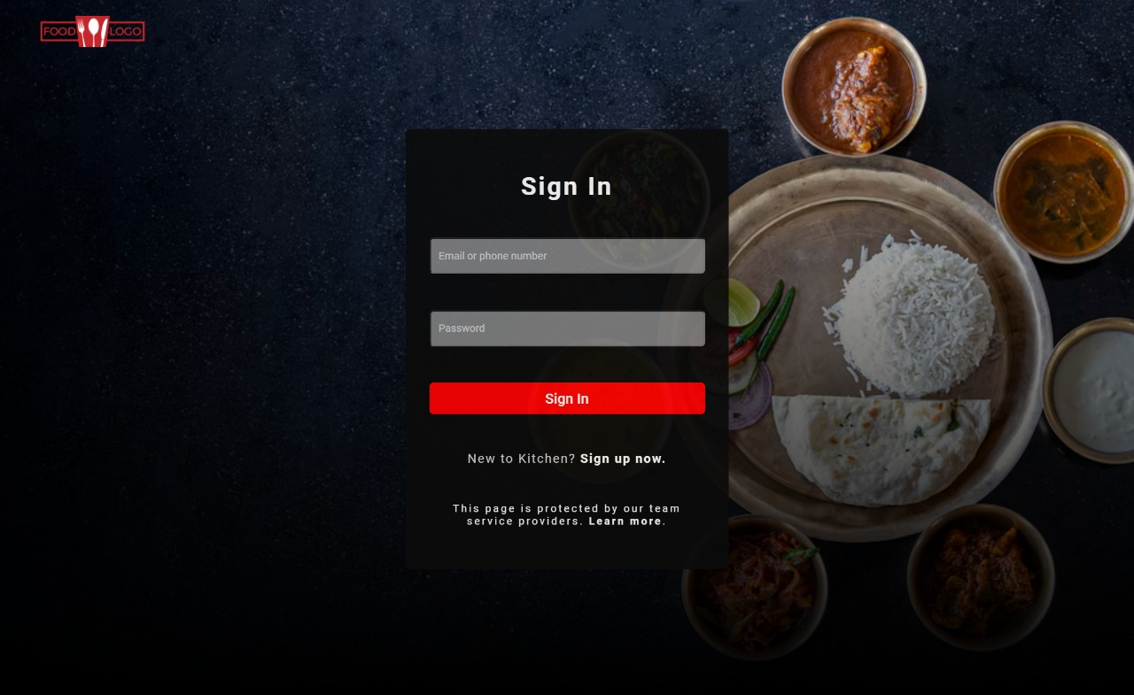
Snapshots (Cont...)

Slide 16
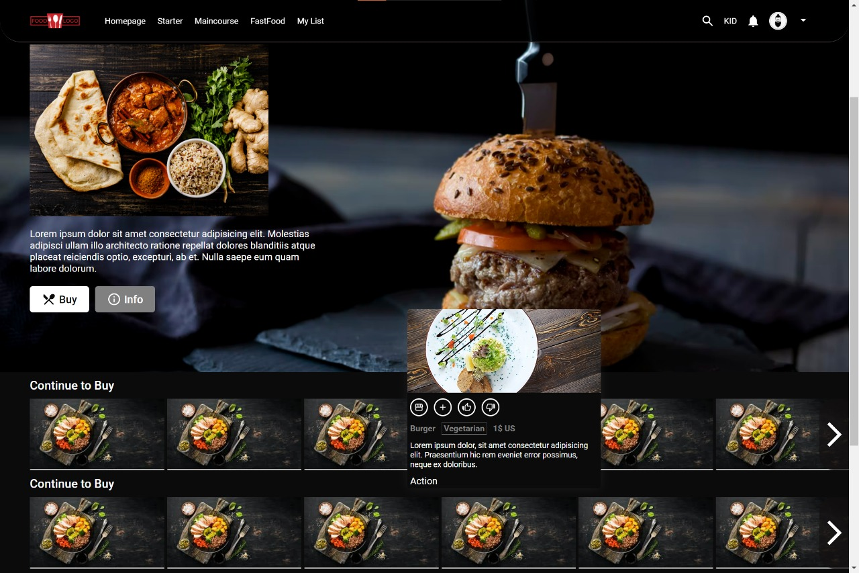
Snapshots (Cont...)

Slide 17
Results and Conclusion
We were successfully able to design a web app having full stack capabilites
This app can be used to search food category wise and and add it to the cart.
When the cart is not empty we can review our meal and proceed to checkout.
After checking out we can enjoy our meal at our place.

Slide 18
References
MDN Web Docs
https://developer.mozilla.org/en-US/
W3Schools Online Web Tutorials
https://www.w3schools.com/
The Complete 2022 Web Development
https://www.udemy.com/course/the-complete-web-development-bootcamp/
Burdman, Jessica, “Collaborative Web Development” Addison Wesley
Xavier, C, “ Web Technology and Design” , New Age International

